Slide 1
Standard Extension Functions
2019

Slide 2
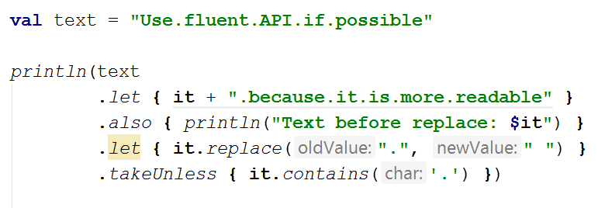
Standard extension functions
also()
apply()
let()
takeIf()
takeUnless()
with()
run()

Slide 3
Standard extension functions
public inline fun <T> T.also(block: (T) -> Unit): T
public inline fun <T, R> T.let(block: (T) -> R): R
public inline fun <T> T.apply(block: T.() -> Unit): T
public inline fun <T, R> T.run(block: T.() -> R): R
public inline fun <T, R> with(receiver: T, block: T.() -> R): R
public inline fun <T> T.takeIf(predicate: (T) -> Boolean): T?
public inline fun <T> T.takeUnless(predicate: (T) -> Boolean): T?

Slide 4
Standard extension functions
Extension function a safe call
val list: List<String?> = listOf("Kotlin", null) for (item in list) { item?.let { println(it) } // prints A and ignores null }
safe call

Slide 5
Standard extension functions
Kdy kterou použít?
Potřebuji rozšiřující funkci?
Potřebuji this, nebo it
Potřebuji vrátit this, nebo ne?
Zdroj

Slide 6
Standard extension functions
Potřebuji rozšiřující funkci?
public inline fun <T, R> with(receiver: T, block: T.() -> R): R
with(webview.settings) { this?.javaScriptEnabled = true this?.databaseEnabled = true }
public inline fun <T, R> T.run(block: T.() -> R): R
webview.settings?.run { javaScriptEnabled = true databaseEnabled = true }

Slide 7
Standard extension functions
Potřebuji this, nebo it
public inline fun <T, R> T.run(block: T.() -> R): R
"This as argument"?.run { println("The length of this String is $this.length") println("The length of this String is $length") }
this mohu většinou úplně vynechat
public inline fun <T, R> T.let(block: (T) -> R): R
"it as argument"?.let { println("The length of this String is ${it.length}") }
mohu použít jiný název než it

Slide 8
Standard extension functions
Potřebuji vrátit this nebo ne?
public inline fun <T> T.apply(block: T.() -> Unit): T
public inline fun <T> T.also(block: (T) -> Unit): T
public inline fun <T, R> T.let(block: (T) -> R): R

Slide 9
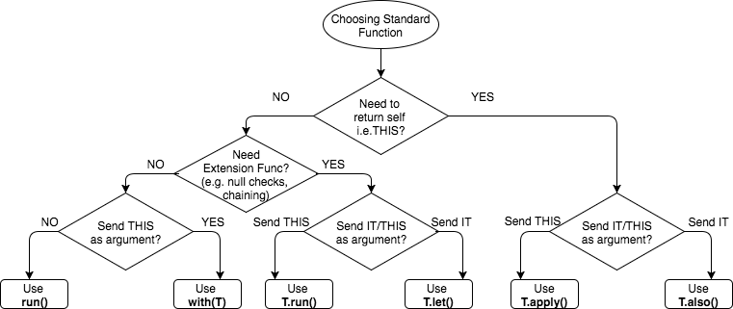
Standard extension functions

Slide 10
Typical usecase - let()
převod z jednoho typu na druhý
nullability handling
val answerToUniverse = strBuilder.let { it.append("Douglas Adams was right after all") it.append("Life, the Universe and Everything") 42 }
str?.let { print(it) }

Slide 11
Typical usecase - apply()
inicializace, nebo konfigurace objektu
val andre = Person() andre.name = "andre" andre.company = "Viacom" andre.hobby = "losing in ping pong"
val andre = Person().apply { name = "Andre" company = "Viacom" hobby = "losing in ping pong" }

Slide 12
Typical usecase - also()
Vedlejší efekty při zřetězených voláních
val rawData = api.getData() Log.debug(rawData) rawData.map { /** other stuff */ }
api.getData() .also { Log.debug(it) } .map { /** other stuff */ }

Slide 13
Typical usecase - with()
Logické seskupení volání operací na objektu
messageBoard.init(“https://url.com”) messageBoard.login(token) messageBoard.post(“Kotlin’s a way of life bro")
with(messageBoard) { init(“https://url.com”) login(token) post(“Kotlin’s a way of life bro") }

Slide 14
Typical usecase - run()
Stejný jako let, ale umožňuje přístup přes receiver
public inline fun <T, R> T.let(block: (T) -> R): R
public inline fun <T, R> T.run(block: T.() -> R): R
val answerToUniverse = strBuilder.let { it.append("Douglas Adams was right after all") it.append("Life, the Universe and Everything") 42 }
val answerToUniverse2 = strBuilder.run { append("Douglas Adams was right after all") append("Life, the Universe and Everything") 42 }

